Slide 1
Unit V Macros

Slide 2
Table of content
Understanding Excel Macros
Activating the Developer Tab in Excel
Creating a Macro with the Macro Recorder
Editing a Macro with VBA
Creating Buttons to Run Macros

Slide 3
1. Understanding Excel Macros
A macro is an action or a set of actions that you can run as many times as you want.
When you create a macro, you are recording your mouse clicks and keystrokes.
After you create a macro, you can edit it to make minor changes to the way it works.

Slide 4
When to use VBA and why
Automation and repetition
Extensions to user interaction
Doing things another way
Useful Code
Application.ActiveDocument.Save
Application.ActiveDocument.SaveAs ("Doc Name.docx")
Application.ActiveSheet.Range("A1").Select
Application.Selection.Value = "Hello World"
https://learn.microsoft.com/en-us/office/vba/library-reference/concepts/getting-started-with-vba-in-office

Slide 5
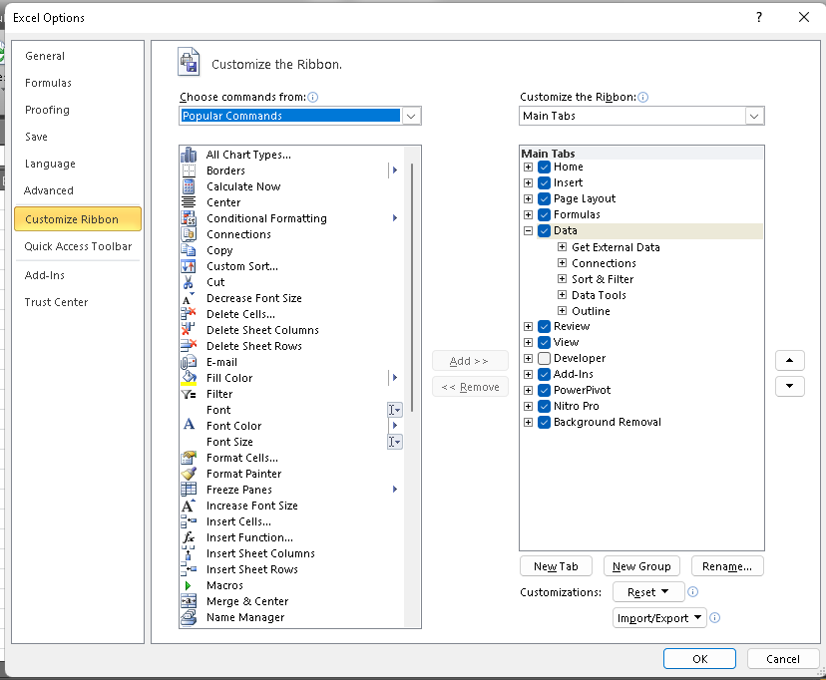
2. Activating the Developer Tab in Excel

Slide 6
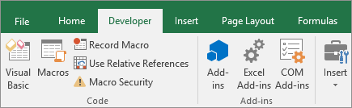


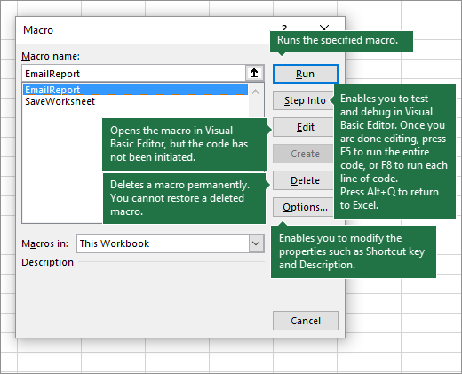
3. Creating a Macro with the Macro Recorder

Slide 7
To-do macro task
Eg: Format similar data using the macro

Slide 8
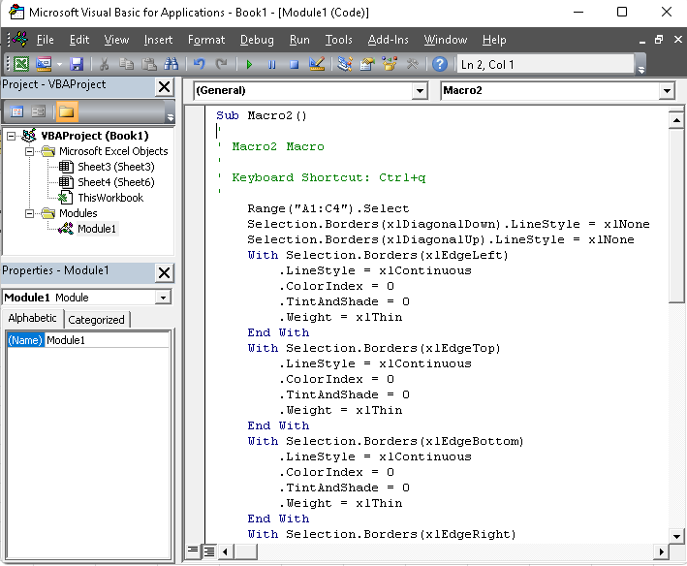
4. Editing a Macro with VBA

Slide 9
VBA stands for Visual Basic for Applications, an event-driven programming language from Microsoft.
Go to developer tab
INERT BUTTON
RIGHT CLICK >> ASIGN MACRO
Accessing VBA Editor, press "ALT+F11".
Private Sub say_helloworld_Click()
MsgBox "Hi"
End Sub
Any statement that starts with a Single Quote ( ‘ ) or "REM“ is treated as comment.
REM This is comment
‘ This is comment

Slide 10
The MsgBox function displays a message box and waits for the user to click a button and then an action is performed based on the button clicked by the user.
Syntax
MsgBox(prompt[,buttons][,title][,helpfile,context])
Function Msg()
'Message Box with just prompt message
MsgBox ("Welcome")
End Function

Slide 11
Function Msg_B()
a = MsgBox("Do you like Macro?", vbOKCancel, "Choose options")
Msg_B = a
End Function
Retunes: 1 - OK was clicked, 2 - Cancel was clicked
Function Msg_B()
a = MsgBox("Do you like Macro?", vbOKCancel, "Choose options")
MsgBox ("The Value of a is " & a)
Msg_B = a
End Function

Slide 12
Function area()
Dim l As Double
Dim w As Double
l = InputBox("Enter Length ", "Enter a Number")
w = InputBox("Enter Width", "Enter a Number")
area = l * w
End Function

Slide 13
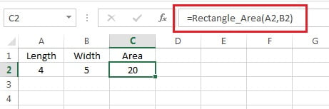
Function Rectangle_Area(length As Double, Optional width)
If IsMissing(width) Then
Rectangle_Area = length * length
Else
Rectangle_Area = length * width
End If
End Function

Slide 14
Dim <<variable_name>> As <<variable_type>>
Const <<constant_name>> As <<constant_type>> = <<constant_value>>
Function ar(Length As Integer, Width As Integer)
ar = Length * Width
' To Calculate Area 'area' sub proc is called
End Function

Slide 15
When programming using VBA, there are few important objects that a user would be dealing with.
Application Objects:
Workbook Objects
Worksheet Objects
Range Objects
Application.Windows("test.xls").Activate
Application.ActiveCell.Font.Bold = True

Slide 16
Workbooks.Close | Workbooks.Add
Workbooks("Test.xls").Worksheets("Sheet1").Activate
Worksheets(1).Visible = False
Worksheets("Sheet1").Protect password:=strPassword, scenarios:=True
Worksheets("Sheet1").Range("A5").Value = "5235“
Worksheets("Sheet1").Range("A1:A4").Value = 5

Slide 17
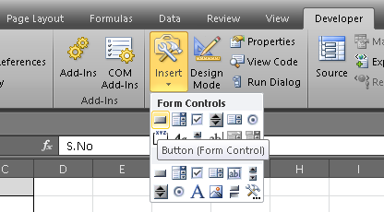
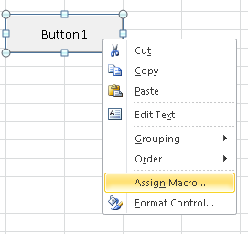
5. Creating Buttons to Run Macros

Slide 18
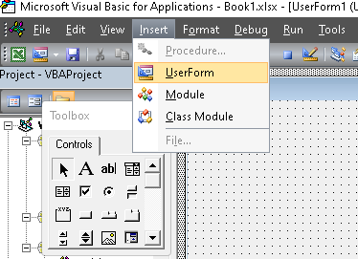

Slide 19
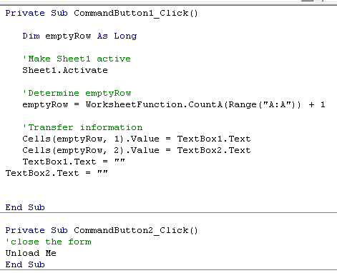

Slide 20
Private Sub CommandButton1_Click()
Dim emptyRow As Long
'Make Sheet1 active
Sheet1.Activate
'Determine emptyRow
emptyRow = WorksheetFunction.CountA(Range("A:A")) + 1
'Transfer information
Cells(emptyRow, 1).Value = TextBox1.Text
Cells(emptyRow, 2).Value = TextBox2.Text
TextBox1.Text = ""
TextBox2.Text = ""
End Sub
Private Sub CommandButton2_Click()
'close the form
Unload Me
End Sub

Slide 21
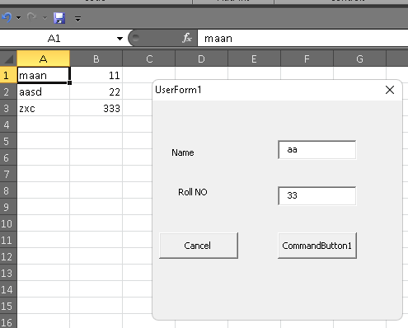

Slide 22
Thank You

